Slide 1
Unified Modeling Language (UML)
Amir Dirin Spring 2023

Slide 2
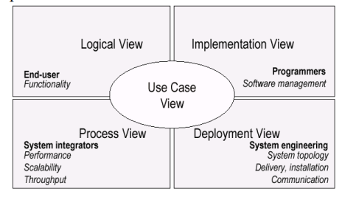
What is UML
Unified Modeling Language
OMG Standard, Object Management Group
Based on work from Booch, Rumbaugh, Jacobson
UML is a modeling language to express and design documents software
Useful for OO design
Not a process, but some been proposed using UML
Independent of implementation language

Slide 3
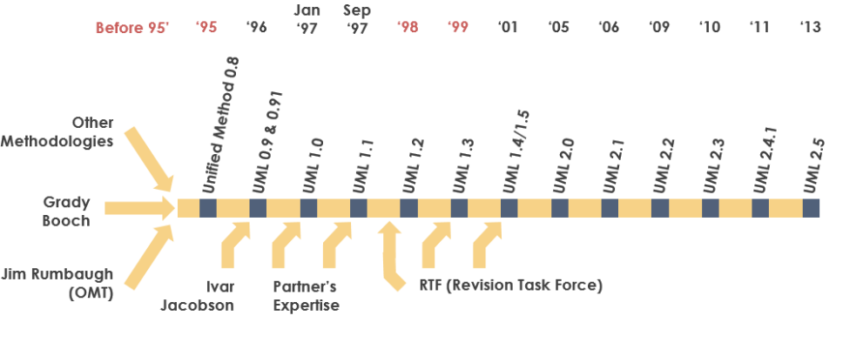
Why use UML
Open Standard, Graphical notation for
Specifying, visualizing, constructing, and documenting software system
Increase understanding/communication of product to customers and developers
Support for diverse application areas
History of the UML
https://www.uml-diagrams.org/
https://www.visual-paradigm.com/guide/uml-unified-modeling-language/what-is-uml/

Slide 4
Tools
Prosa UML https://www.insoft.fi/
Rational Rose https://www.ibm.com/docs/kk/rsar/9.5?topic=migration-rational-rose-model
Online UML tools
https://www.guru99.com/best-uml-tools.html
Star UML (*)
https://staruml.io/

Slide 5
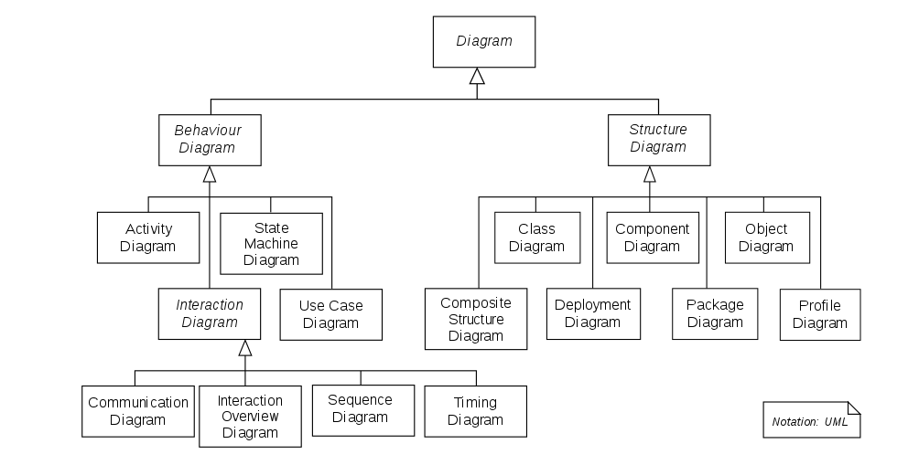
UML DIAGRAM

Slide 6
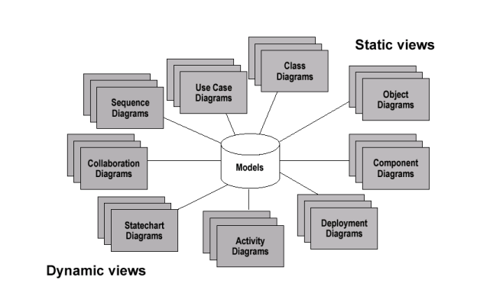
UML Baseline
Use Case Diagrams
Class Diagrams
Package Diagrams
Interaction Diagrams
Sequence
Collaboration
Activity Diagrams
State Transition Diagrams
Deployment Diagrams

Slide 7
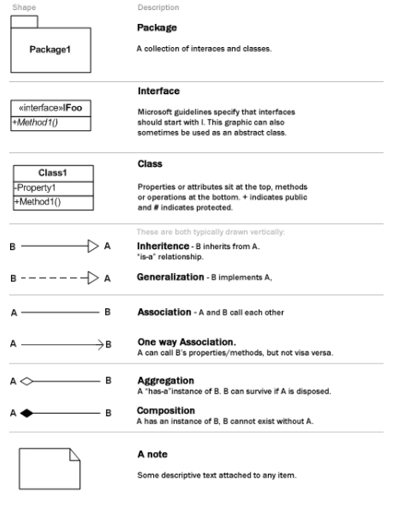
UML Cheat Sheet

Slide 8
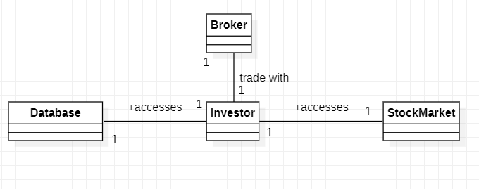
Object class
Show instances of Class Diagram and links among them

Slide 9
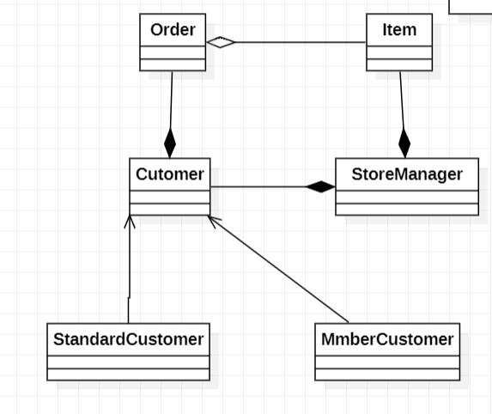
Object interaction

Slide 10
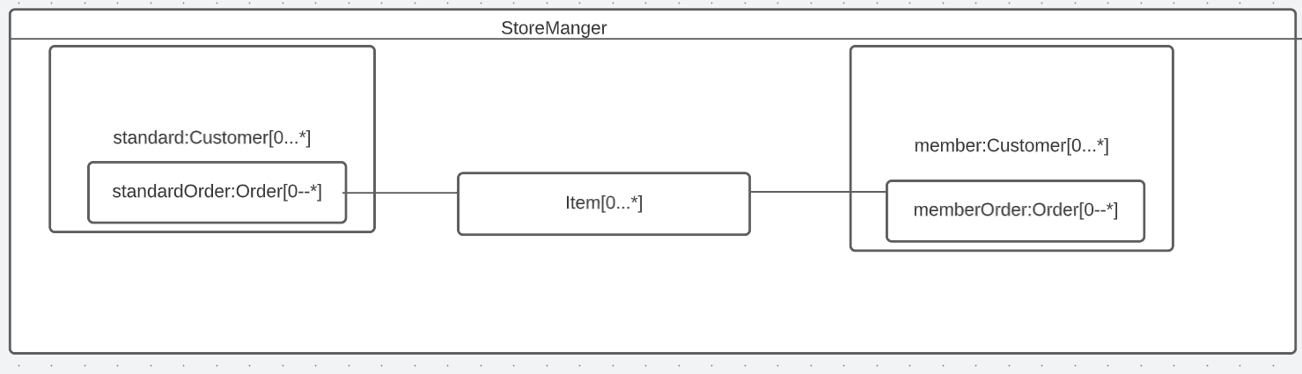
Composit Diagram
A good approach to describe the aggregations

Slide 11
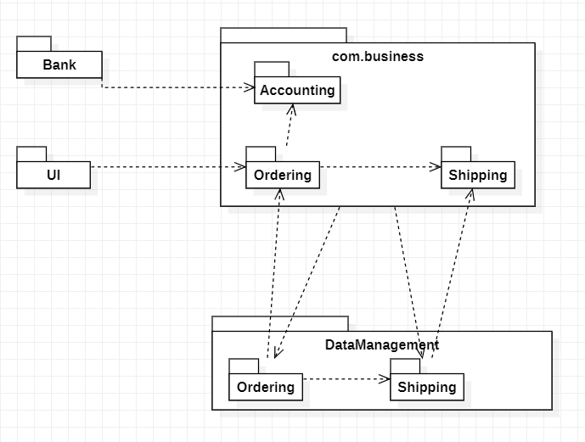
Package Diagram
Dependency

Slide 12
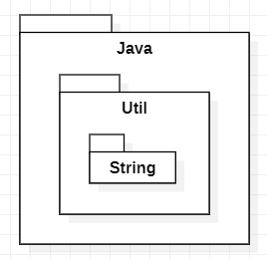
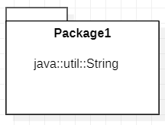
Package
OR

Slide 13
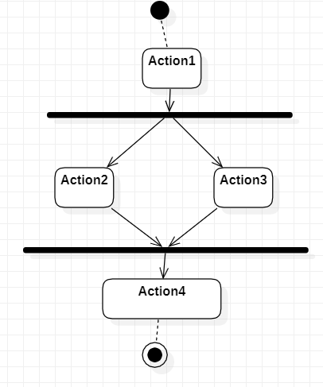
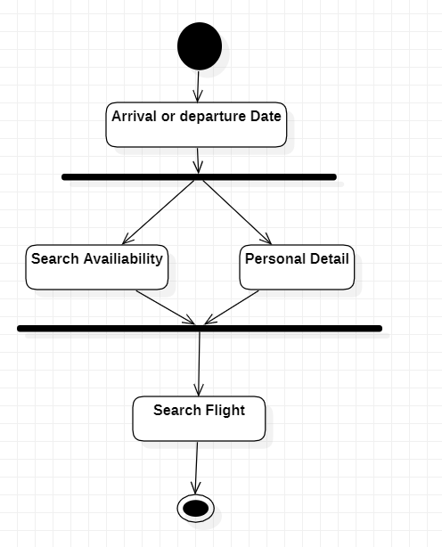
Activity Diagram

Slide 14
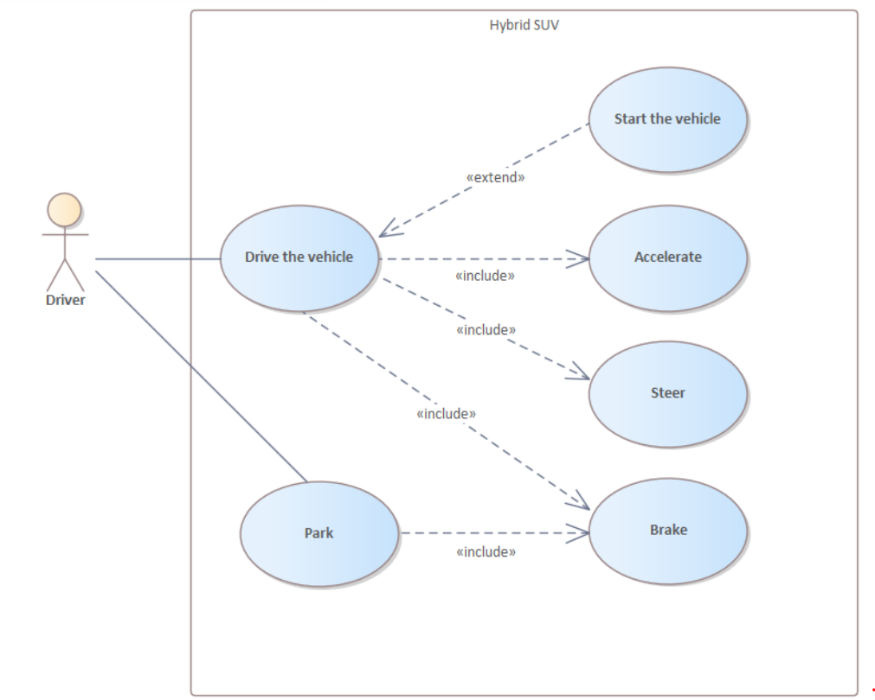
Use Case Diagram
Type of use case description
High level- A general description:
Expanded (detailed)-step by step
Essential-free of technological detail
Real-adds technological detail
The use case diagram describes the relationship between the actors and the Use Cases.

Slide 15
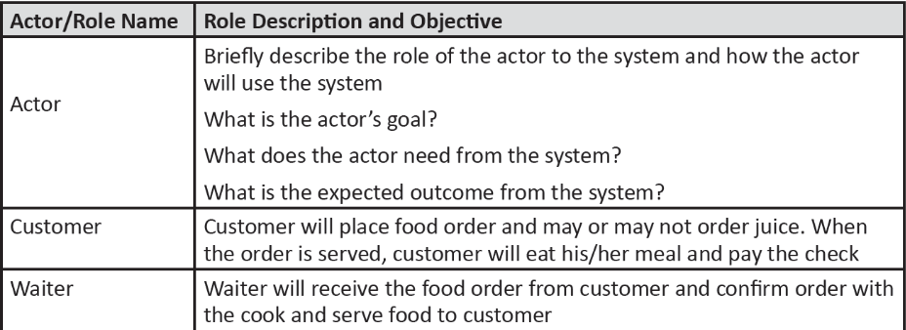
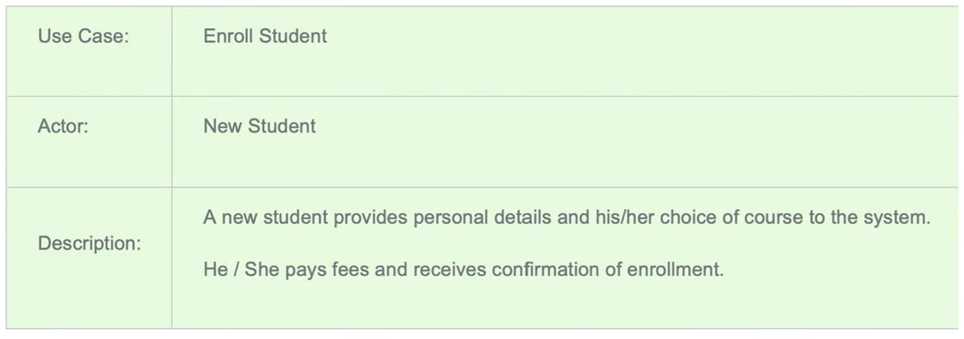
High-level of use case description
http://mohamedelgendy.com/blog/how-to-write-a-use-case-document.html

Slide 16
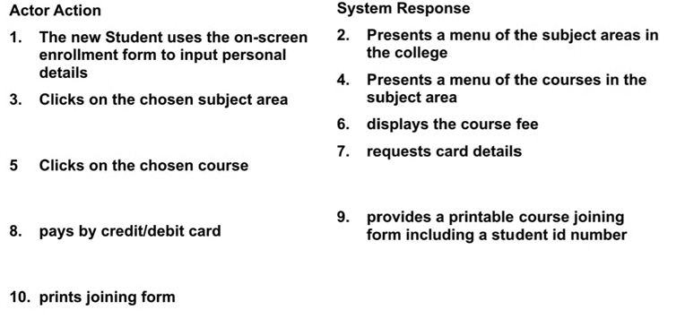
Expanded (detailed)-step by step
Enroll to a course

Slide 17
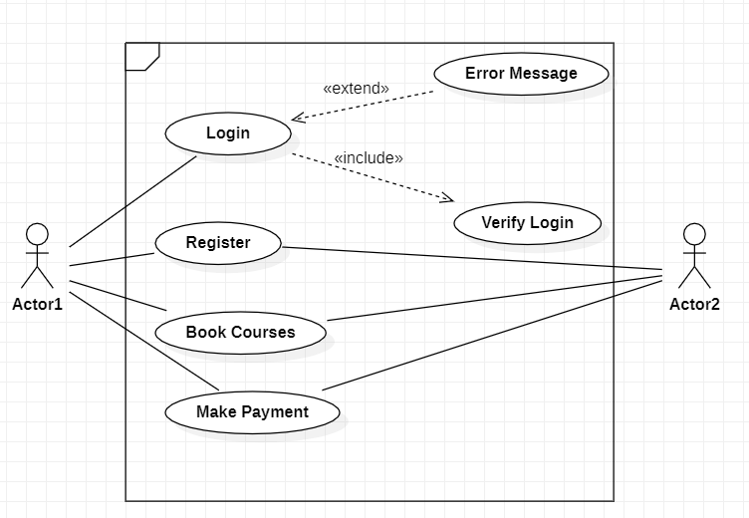
Use Case diagram

Slide 18

State Machine
State machine used in computer science and related fields to describe the behavior of systems.

Slide 19
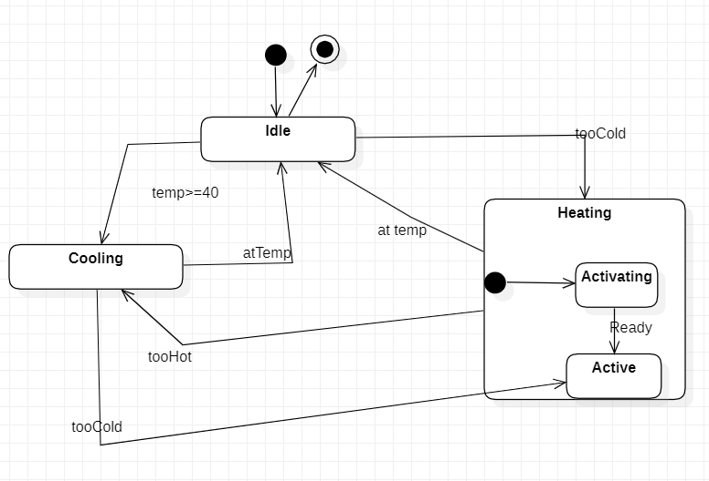
State Machine Diagram

Slide 20
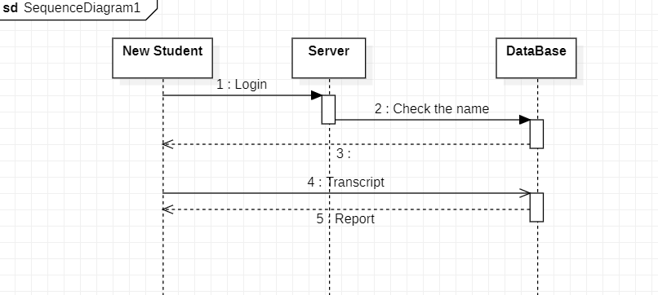
Sequence Diagram
A sequence diagram, shows process interaction arranged in time sequence

Slide 21
Sequence Diagram 2

Slide 22
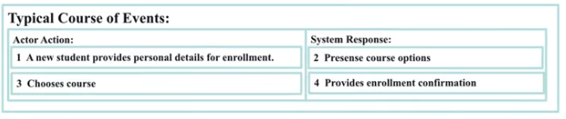
Sequence Diagram
Identified none for classes
Student
Course
Enrollment
We have to define the screen interaction between the use cases

Slide 23
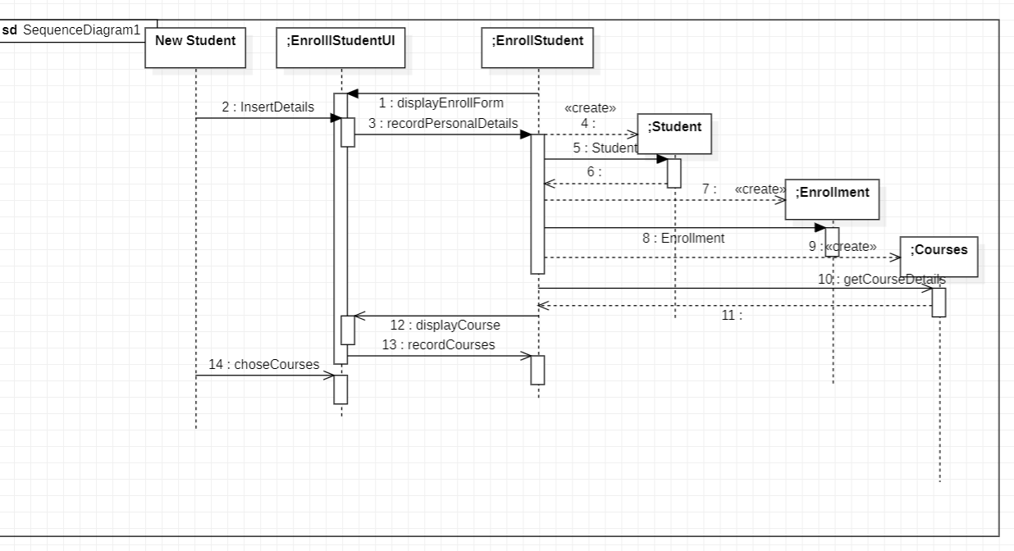
Sequence diagram
Identify the domain classes
Control Object life

Slide 24
EXAMPLE UML
https://www.uml-diagrams.org/examples/online-shopping-example.html

Slide 25
EXERCISE 1
Propose a use case diagram for an ATM machine for withdrawing cash. Make the use case simple yet informative; only include the major features.

Slide 26
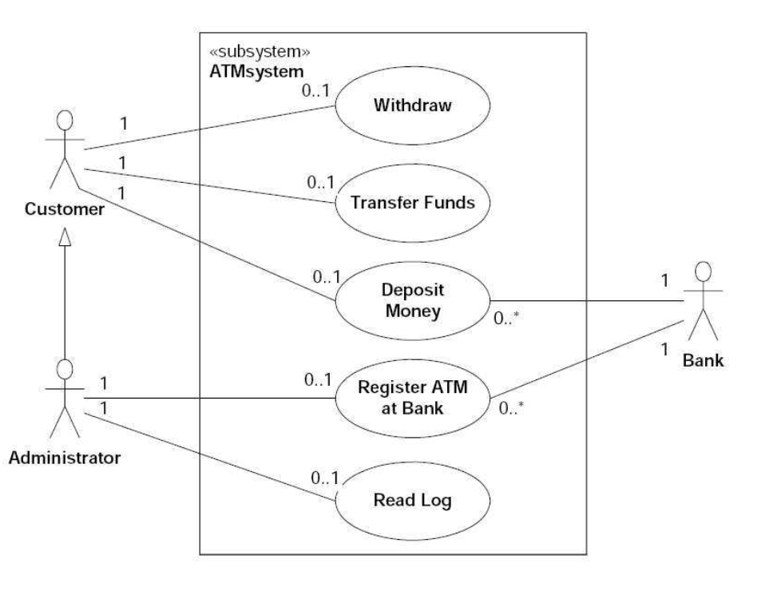
Solution

Slide 27
Exercise II
Propose a use case diagram for a vending machine that sells beverages and snacks. Make use of inclusion and extension associations, mark multiplicities, and remember that a vending machine may need technical assistance from time to time

Slide 28
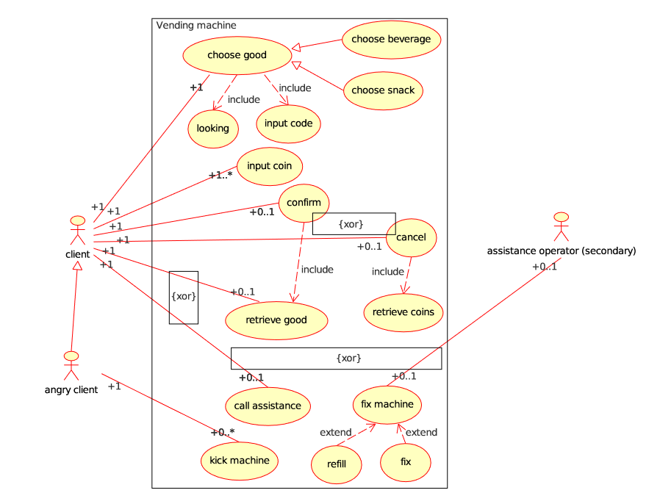
Solution

